Slide 1
Fractals
Ed Angel
Professor of Computer Science, Electrical and Computer Engineering, and Media Arts
Director, Arts Technology Center
University of New Mexico
Angel: Interactive Computer Graphics 5E © Addison-Wesley 2009

Slide 2
Modeling
Geometric
  Meshes
  Hierarchical
  Curves and Surfaces
Procedural
  Particle Systems
  Fractal
Angel: Interactive Computer Graphics 5E © Addison-Wesley 2009

Slide 3
Sierpinski Gasket
Rule based:
Repeat n times. As n →∞
Area→0
Perimeter →∞
Not a normal geometric object
Angel: Interactive Computer Graphics 5E © Addison-Wesley 2009

Slide 4
Coastline Problem
What is the length of the coastline of England?
Answer: There is no single answer
Depends on length of ruler (units)
If we do experiment with maps at various scales we also notice self-similarity
each part looks a whole
Angel: Interactive Computer Graphics 5E © Addison-Wesley 2009

Slide 5
Fractal Geometry
Created by Mandelbrot
  Self similarity
  Dependence on scale
Leads to idea of fractional dimension
Graftals: graphical fractal objects
Angel: Interactive Computer Graphics 5E © Addison-Wesley 2009

Slide 6

Koch Curve/Snowflake
Angel: Interactive Computer Graphics 5E © Addison-Wesley 2009

Slide 7


Fractal Dimension
Start with unit line, square, cube which we should agree are 1, 2, 3 dimensional respectively under any reasonable dimension
Consider scaling each one by a h = 1/n
Angel: Interactive Computer Graphics 5E © Addison-Wesley 2009

Slide 8
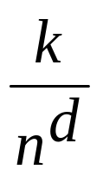
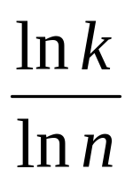
How Many New Objects?
Line: n
Square: n²
Cube: n³
The whole is the sum of its parts implies
= 1
d =
Angel: Interactive Computer Graphics 5E © Addison-Wesley 2009

Slide 9
Examples
Koch Curve
  Scale by 3 each time
  Create 4 new objects
  d = ln 4 / ln 3 = 1.26186
Sierpinski gasket
  Scale by
  Create 3 new objects
  d = ln 3 / ln 4 = 1.58496
Angel: Interactive Computer Graphics 5E © Addison-Wesley 2009

Slide 10


Volumetric Examples
d = ln 4/ ln 2 = 2
D = ln 20 / ln 3 = 2.72683
Angel: Interactive Computer Graphics 5E © Addison-Wesley 2009

Slide 11

Midpoint subdivision
Randomize displacement using a Gaussian random number generator. Reduce displacement each iteration by reducing variance of generator.
Angel: Interactive Computer Graphics 5E © Addison-Wesley 2009

Slide 12
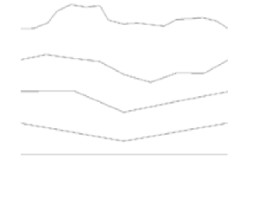
Fractal Brownian Motion
variance ~ length ^{-(2-d)}
Brownian motion d = 1.5
Angel: Interactive Computer Graphics 5E © Addison-Wesley 2009

Slide 13

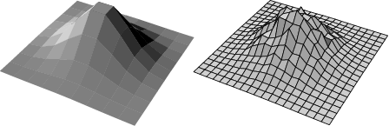
Fractal Mountains
Angel: Interactive Computer Graphics 5E © Addison-Wesley 2009

Slide 14
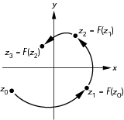
Iteration in the Complex Plane
Angel: Interactive Computer Graphics 5E © Addison-Wesley 2009

Slide 15
Mandelbrot Set
iterate on z_{k+1}=z_{k}²+c
with z₀ = 0 + j0
Two cases as k →∞
|z_{k} |→∞
|z_{k} | remains finite
If for a given c, |z_{k} | remains finite, then c belongs to the Mandelbrot set
Angel: Interactive Computer Graphics 5E © Addison-Wesley 2009

Slide 16
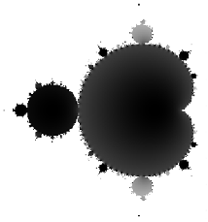
Mandelbrot Set
Angel: Interactive Computer Graphics 5E © Addison-Wesley 2009

Slide 17
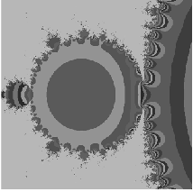
Mandelbrot Set
Angel: Interactive Computer Graphics 5E © Addison-Wesley 2009

